Slide 1




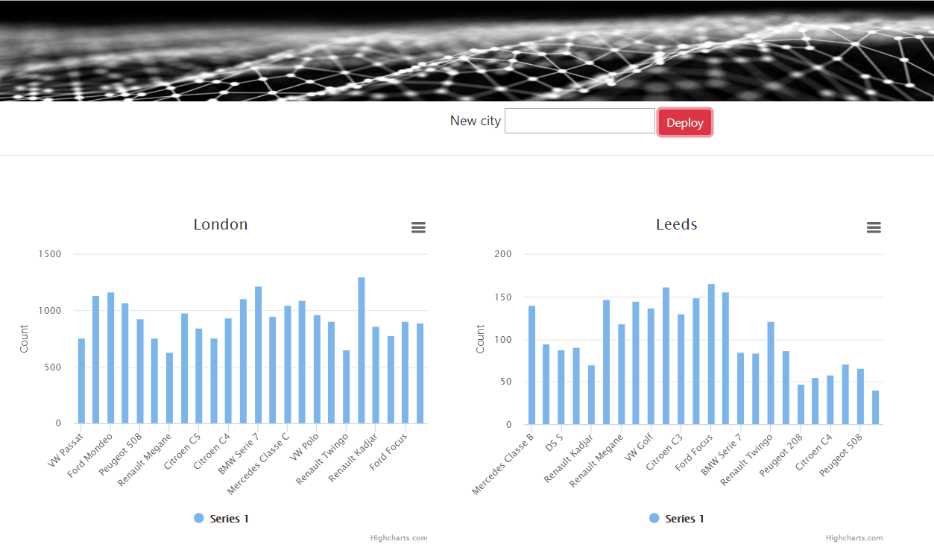


Producer #1
…
Producer #N
Producer #N
…
Producer #1
Cluster central
Stream #1
Stream #1
Stream #N
Stream #N
Edge #1
Edge #N
Stream #N
Stream #N
Edge interface
Stream #1
Stream #1
Edge interface
Central interface

